Slide 1
Computer Organization & Assembly Language (CSC-205)
Lecture 9

Slide 2
Practise Questions
1.) Write an Assembly program that checks if two numbers (in AX and BX) are equal.
If equal, store 1 in CX.
If not equal, store 0 in CX.

Slide 3
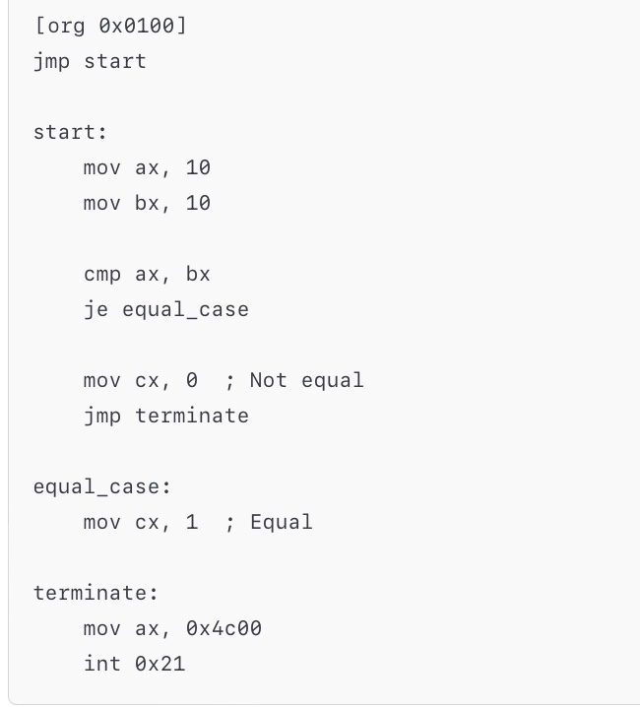
Solution

Slide 4
Practise Questions
2.) Write an Assembly program that takes two numbers in AX and BX and stores the greater number in CX.
Note: Use CMP AX, BX followed by conditional jumps (JG, JL).

Slide 5
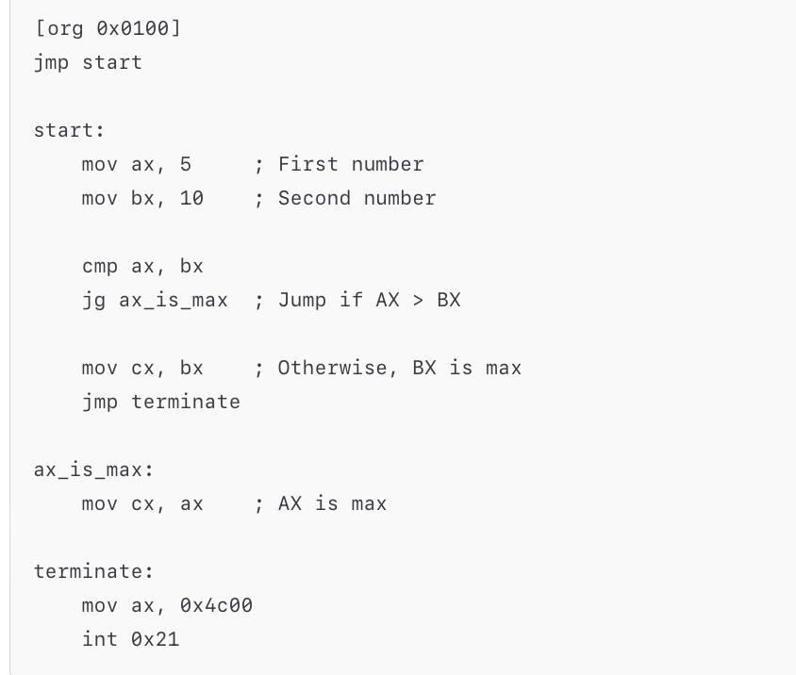
Solution

Slide 6
Practise Questions
3.) Write an Assembly program that takes a number in AX and determines if it is:
Positive → Store 1 in BX
Negative → Store -1 in BX
Zero → Store 0 in BX
Note: Apply one compare condition only and use conditional jumps

Slide 7
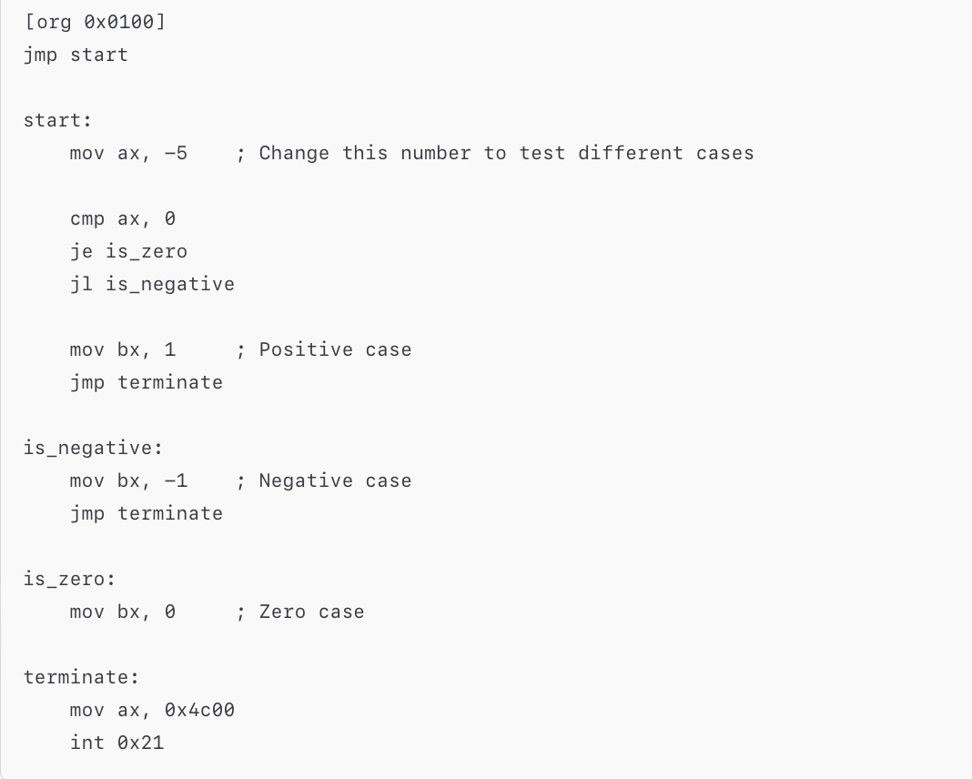
Solution

Slide 8
Practise Questions
4.) Write an Assembly program that counts the number of negative
numbers in an array.
Store the result in CX.
The array ends with -1.
Note: Use a loop and check the sign flag (SF) using JS.

Slide 9
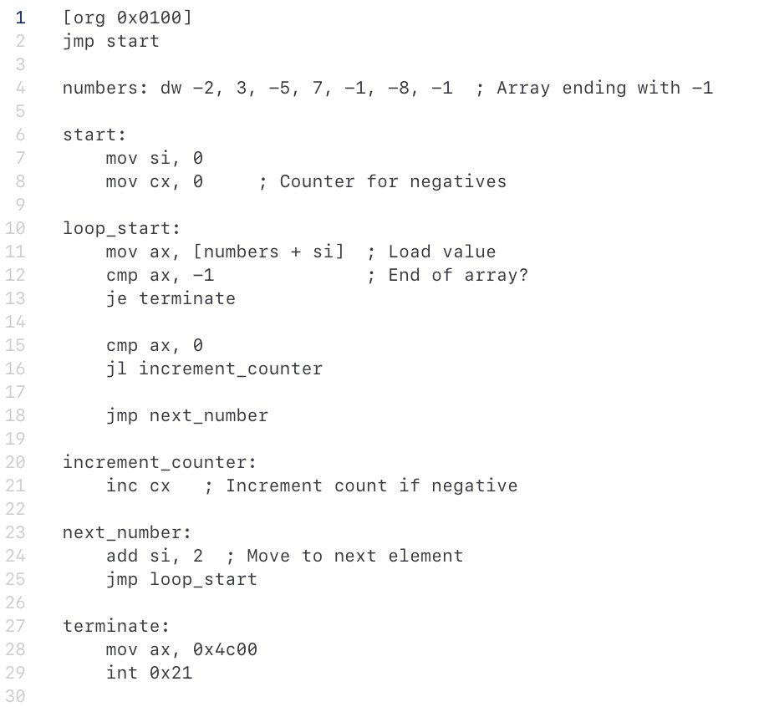
Solution

Slide 10
End of Lecture

